Slide 1
CORE JAVA PROGRAMMING
AN INTRODUCTION TO JAVA
Presented By
Dr. Eman Hesham, DBA.

Slide 2
Agenda
A.
The History and Evolution of Java
B.
An Overview of Java
C.
Data Types, Variables and Arrays
D.
Operators, Control Statements and String Handling
E.
Modifiers, Access Specifiers, Packages and Interfaces
F.
Wrapper Classes, Autoboxing and Inner Classes
G.
Exception Handling
H.
Generics and Lambda Expressions
I.
Java Stream API
J.
Java Collections
K.
Multi-Threading in Java

Slide 3
Agenda
A.
The History and Evolution of Java
B.
An Overview of Java
C.
Data Types, Variables and Arrays
D.
Operators, Control Statements and String Handling
E.
Modifiers, Access Specifiers, Packages and Interfaces
F.
Wrapper Classes, Autoboxing and Inner Classes
G.
Exception Handling
H.
Generics and Lambda Expressions and Method Reference
I.
Java Stream API
J.
Java Collections
K.
Multi-Threading in Java

Slide 4

Lesson 10 Java Collections

Slide 5
Introduction to Java Collection Framework
The data structures that you choose can make a big difference when you try to implement methods in a natural style or are concerned with performance.
Do you need to search quickly through thousands (or even millions) of sorted items?
Do you need to rapidly insert and remove elements in the middle of an ordered sequence?
Do you need to establish associations between keys and values?

Slide 6
Interfaces in the Collections Framework
Map
Iterator
ListIterator
RandomAccess
SortedMap
NavigableMap
Iterable
Collection
List
Set
Queue
Deque
SortedSet
NavigableSet

Slide 7
Interfaces in the Collections Framework
A List is an ordered collection. Elements are added into a particular position in the container.
The ListIterator interface is a subinterface of Iterator. It defines a method for adding an element before the iterator position.
The Set interface is identical to the Collection interface, but the behavior of the methods is more tightly defined. The add method of a set should reject duplicates.

Slide 8
Interfaces in the Collections Framework
The SortedSet and SortedMap interfaces expose the comparator object used for sorting, and they define methods to obtain views of subsets of the collections.
Java SE 6 introduced interfaces NavigableSet and NavigableMap that contain additional methods for searching and traversal in sorted sets and maps.
The TreeSet and TreeMap classes implement these interfaces.

Slide 9
Concrete Collections
The following slides show the collections in the Java library and briefly describes the purpose of each collection class.
All classes in the below table implement the Collection interface, with the exception of the classes with names ending in Map. Those classes implement the Map interface instead.

Slide 10
Classes in the collections framework
AbstractCollection
AbstractList
AbstractSet
AbstractQueue
AbstractSequentialList
LinkedList
ArrayList
HashSet
EnumSet
TreeSet
LinkedHashSet
PriorityQueue
ArrayQueue

Slide 11
Classes in the collections framework
AbstractMap
HashMap
EnumMap
LinkedHashMap
TreeMap
WeakHashMap
IdentityHashMap

Slide 12
Classes in the collections framework
Collection Type | Description
ArrayList | An indexed sequence that grows and shrinks dynamically
LinkedList | An ordered sequence that allows efficient insertion and removal at any location
ArrayDeque | A double-ended queue that is implemented as a circular array
HashSet | An unordered collection that rejects duplicates
TreeSet | A sorted set
EnumSet | A set of enumerated type values
LinkedHashSet | A set that remembers the order in which elements were inserted
PriorityQueue | Elements are ordered according to their natural ordering, or by a Comparator provided at queue construction time

Slide 13
Classes in the collections framework
Collection Type | Description
HashMap | A data structure that stores key/value associations
TreeMap | A map in which the keys are sorted
EnumMap | A map in which the keys belong to an enumerated type
LinkedHashMap | A map that remembers the order in which entries were added
WeakHashMap | A map with values that can be reclaimed by the garbage collector if they are not used elsewhere
IdentityHashMap | A map with keys that are compared by ==, not equals

Slide 14
Linked Lists
Arrays and ArrayList are used frequently when we are developing different applications.
However, arrays and array lists suffer from a major drawback.
Removing an element from the middle of an array is expensive since all array elements beyond the removed one must be moved toward the beginning of the array. The same is true for inserting elements in the middle.
Another well-known data structure, the linked list, solves this problem.

Slide 15
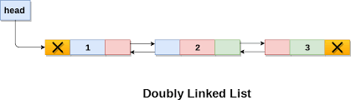
Linked Lists
While an array stores object references in consecutive memory locations, a linked list stores each object in a separate link.
Each link also stores a reference to the next link in the sequence.
In the Java programming language, all linked lists are actually doubly linked; that is, each link also stores a reference to its predecessor
Removing an element from the middle of a linked list is an inexpensive operation—only the links around the element to be removed need to be updated

Slide 16
Linked Lists
The following code example adds three elements and then removes the second one:
// LinkedList implements List
List<String> staff = new LinkedList<>();
staff.add(“First");
staff.add(new String(“Second“));
staff.add(“Third");
Iterator iter = staff.iterator();
String first = iter.next(); // visit first element
String second = iter.next(); // visit second element
iter.remove(); // remove last visited element

Slide 17
Linked Lists
A linked list is an ordered collection in which the position of the objects matters.
The LinkedList.add method adds the object to the end of the list. But you will often want to add objects somewhere in the middle of a list.
This position dependent add method is the responsibility of an iterator, since iterators describe positions in collections.
Using iterators to add elements makes sense only for collections that have a natural ordering.

Slide 18
Linked Lists
List<String> numbers = new LinkedList<>();
numbers.add("First");
numbers.add("Second");
numbers.add("Third");
ListIterator<String> iter = numbers.listIterator();
iter.next(); // skip past first element
iter.add("Before Second");

Slide 19
Linked Lists - Example
The following program puts linked lists to work.
It simply creates two lists, merges them, then removes every second element from the second list, and finally tests the removeAll method.

Slide 20
Linked Lists - Example
import java.util.*;
public class LinkedListTest
{
public static void main(String[] args)
{
List<String> a = new LinkedList<>();
a.add(“A");
a.add(“B");
a.add(“C");
List<String> b = new LinkedList<>();
b.add(“D");
b.add(“E");
b.add(“F");
b.add(“G");

Slide 21
Linked Lists - Example
// merge the words from b into a
ListIterator<String> aIter = a.listIterator();
Iterator<String> bIter = b.iterator();
while (bIter.hasNext()){
if (aIter.hasNext()) aIter.next();
aIter.add(bIter.next());
}
System.out.println(a);
// remove every second word from b
bIter = b.iterator();
while (bIter.hasNext()){
bIter.next(); // skip one element
if (bIter.hasNext())
{
bIter.next(); // skip next element
bIter.remove(); // remove that element
} }
System.out.println(b);
[A, D, B, E, C, F, G]
[D, F]

Slide 22
Linked Lists - Example
// bulk operation: remove all words in b from a
a.removeAll(b);
System.out.println(a);
}
}
[A, B, E, C, G]

Slide 23
Lists
Hint: Java List is an ordered collection.
Provides control over the position where you can insert an element.
List allows you to add duplicate elements.
List allows you to have ‘null’ elements.
List interface got many default methods, for example replaceAll, sort and spliterator.
List indexes start from 0, just like arrays.
List supports Generics and we should use it whenever possible.
Using Generics with List will avoid ClassCastException at runtime.

Slide 24
Maps
A set is a collection that lets you quickly find an existing element.
However, to look up an element, you need to have an exact copy of the element to find.
That isn’t a very common lookup—usually, you have some key information, and you want to look up the associated element.
The map data structure serves that purpose.
A map stores key/value pairs. You can find a value if you provide the key.

Slide 25
Basic Map Operations
The Java library supplies two general-purpose implementations for maps: HashMap and TreeMap. Both classes implement the Map interface.
A hash map hashes the keys, and a tree map uses an ordering on the keys to organize them in a search tree.
The hash or comparison function is applied only to the keys. The values associated with the keys are not hashed or compared.

Slide 26
Basic Map Operations
Here is how you set up a hash map for storing employees:
//HashMap implements Map
Map<String, Employee> staff = new HashMap<>();
Employee amr = new Employee(“Amr Mostafa");
staff.put("987-98-9996", amr);
Whenever you add an object to a map, you must supply a key as well. In our case, the key is a string, and the corresponding value is an Employee object.

Slide 27
Basic Map Operations
To retrieve an object, you must use (and, therefore, remember) the key.
String id = "987-98-9996";
e = staff.get(id);
If no information is stored in the map with the particular key specified, get returns null.

Slide 28
Basic Map Operations
The null return value can be inconvenient.
Sometimes, you have a good default that can be used for keys that are not present in the map. Then use the getOrDefault method.
Map<String, Integer> scores = . . .;
int score = scores.get(id, 0); // Gets 0 if the id is not present
Keys must be unique. You cannot store two values with the same key.
If you call the put method twice with the same key, the second value replaces the first one.
In fact, put returns the previous value associated with its key parameter.

Slide 29
Basic Map Operations
The remove method removes an element with a given key from the map.
The size method returns the number of entries in the map.
The easiest way of iterating over the keys and values of a map is the forEach method.
Provide a lambda expression that receives a key and a value. That expression is invoked for each map entry in turn.
scores.forEach((k, v) -> System.out.println("key=" + k + ", value=" + v));

Slide 30
Basic Map Operations - Example
We first add key/value pairs to a map.
Then, we remove one key from the map, which removes its associated value as well.
Next, we change the value that is associated with a key and call the get method to look up a value. Finally, we iterate through the entry set.

Slide 31
Basic Map Operations - Example
public class Employee {
private String name;
public Employee(String name) {
this.setName(name);
}
public String getName() {
return name;
}
public void setName(String name) {
this.name = name;
}
public String toString() {
return "Employee Name "+name;
}
}

Slide 32
Basic Map Operations - Example
import java.util.*;
public class MapTest {
public static void main(String[] args) {
Map<String, Employee> staff = new HashMap<>();
staff.put("144-25-5464", new Employee(“Amr"));
staff.put("567-24-2546", new Employee(“Mohsen"));
staff.put("157-62-7935", new Employee(“Medhat"));
staff.put("456-62-5527", new Employee(“Eman"));

Slide 33
Basic Map Operations - Example
// print all entries
System.out.println(staff);
// remove an entry
staff.remove("567-24-2546");
// replace an entry
staff.put("456-62-5527", new Employee(“Mona"));
// look up a value
System.out.println(staff.get("157-62-7935"));
// iterate through all entries
staff.forEach((k, v) ->
System.out.println("key=" + k + ", value=" + v));
}
}

Slide 34
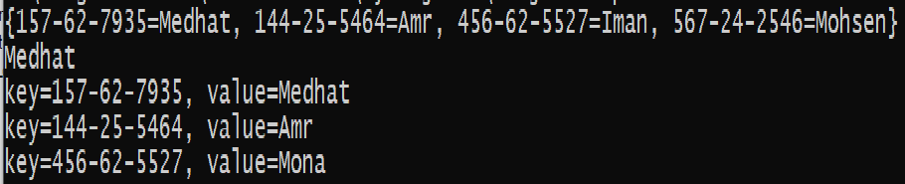
Map Example-Output
{157-62-7935=collections.maps.Employee@7960847b, 144-25-5464=collections.maps.Employee@6a6824be, 456-62-5527=collections.maps.Employee@5c8da962, 567-24-2546=collections.maps.Employee@512ddf17}
collections.maps.Employee@7960847b
key=157-62-7935, value=collections.maps.Employee@7960847b
key=144-25-5464, value=collections.maps.Employee@6a6824be
key=456-62-5527, value=collections.maps.Employee@5f5a92bb

Slide 35
Lesson 9 Java Stream API

Slide 36
Stream API
Java SE 8 introduces the concept of streams.
Streams are objects of classes that implement interface Stream (from the package java.util.stream) or one of the specialized stream interfaces for processing collections of int, long or double values.
Together with lambdas, streams enable you to perform tasks on collections of elements—often from an array or collection object.

Slide 37
Stream API: Stream Pipelines
Streams move elements through a sequence of processing steps—known as a stream pipeline—that begins with a data source (such as an array or collection), performs various intermediate operations on the data source’s elements and ends with a terminal operation.
A stream pipeline is formed by chaining method calls.
Unlike collections, streams do not have their own storage—once a stream is processed, it cannot be reused, because it does not maintain a copy of the original data source.

Slide 38
Stream API: Stream Pipelines
Source
Intermediate Operations
Intermediate Operations
Terminal Operation
.stream()
.filter(b -> b.getColor()== red)
.mapToInt( b -> b.getWeight())
.sum();

Slide 39
Stream API: Intermediate Operations
An intermediate operation specifies tasks to perform on the stream’s elements and always results in a new stream.
Intermediate operations are lazy—they aren’t performed until a terminal operation is invoked.
This allows library developers to optimize stream-processing performance.

Slide 40
Stream API: Intermediate Operations
For example, if you have a collection of 1,000,000 Person objects and you’re looking for the first one with the last name "Jones", stream processing can terminate as soon as the first such Person object is found.

Slide 41
Stream API: Terminal Operations
A terminal operation initiates processing of a stream pipeline’s intermediate operations and produces a result.
Terminal operations are eager—they perform the requested operation when they are called.
The Below tables show some common intermediate and terminal operations

Slide 42
Stream API: Common Intermediate Stream Operations
Operation | Description
Filter | Results in a stream containing only the elements that satisfy a condition.
distinct | Results in a stream containing only the unique elements.
limit | Results in a stream with the specified number of elements from the beginning of the original stream.
map | Results in a stream in which each element of the original stream is mapped to a new value (possibly of a different type. The new stream has the same number of elements as the original stream.
sorted | Results in a stream in which the elements are in sorted order. The new stream has the same number of elements as the original stream.

Slide 43
Stream API: Common Terminal Stream Operations
Loop
forEach- Performs processing on every element in a stream (e.g., display each element).
Reduction operations
Take all values in the stream and return a single value
Mutable reduction operations
Create a container (such as a collection or StringBuilder)
Search operations
Performs different search or match operations on a stream

Slide 44
Stream API: Common Terminal Stream Operations
Operation | Reduction operations
average | Calculates the average of the elements in a numeric stream.
count | Returns the number of elements in the stream.
max | Locates the largest value in a numeric stream.
min | Locates the smallest value in a numeric stream.
reduce | Reduces the elements of a collection to a single value using an associative accumulation function (e.g., a lambda that adds two elements).

Slide 45
Stream API: Common Terminal Stream Operations
Operation | Mutable Reduction operations
collect | Creates a new collection of elements containing the results of the stream’s prior operations.
toArray | Creates an array containing the results of the stream’s prior operations..

Slide 46
Stream API: Common Terminal Stream Operations
Operation | Search operations
findFirst | Finds the first stream element based on the prior intermediate operations; immediately terminates processing of the stream pipeline once such an element is found.
findAny | Finds any stream element based on the prior intermediate operations; immediately terminates processing of the stream pipeline once such an element is found.
anyMatch | Determines whether any stream elements match a specified condition; immediately terminates processing of the stream pipeline if an element matches.
allMatch | Determines whether all of the elements in the stream match a specified condition.

Slide 47
Stream API Example
In the following example we will show how to use Stream API and lambda expressions to simplify programming tasks that you probably already performed for Arrays and ArrayLists
The Example demonstrates operations on an IntStream (package java.util.stream)—a specialized stream for manipulating int values.
The techniques shown in this example also apply to LongStreams and DoubleStreams for long and double values, respectively.

Slide 48
Stream API Example
import java.util.stream.IntStream;
public class IntStreamOperations {
public static void main(String[] args) {
int[] values = {3, 10, 6, 1, 4, 8, 2, 5, 9, 7};
// display original values
System.out.print("Original values: ");
IntStream.of(values).forEach(value ->System.out.printf("%d ", value));
System.out.println();

Slide 49

Stream API Example
//count, min, max, sum and average of the values
System.out.printf("%nCount: %d%n", IntStream.of(values).count());
System.out.printf("Min: %d%n", IntStream.of(values).min().getAsInt());
System.out.printf("Max: %d%n", IntStream.of(values).max().getAsInt());
System.out.printf("Sum: %d%n", IntStream.of(values).sum());
System.out.printf("Average: %.2f%n", IntStream.of(values).average().getAsDouble());
Returns OptionalInt which is a container object which may or may not contain an int value

Slide 50

Stream API Example
//sum of values with reduce method
System.out.printf("%nSum via reduce method: %d%n", IntStream.of(values).reduce(0,(x,y)-> x+y));
//sum of squares of values with reduce method
System.out.printf("Sum of squares via reduce method: %d%n",IntStream.of(values)
.reduce(0, (x,y) -> x+y*y));
//product of values with reduce method
System.out.printf("Product via reduce method: %d%n",IntStream.of(values)
.reduce(1,(x,y)->x*y));
The identity value must be an identity for the accumulator function. This means that for all x, accumulator.apply(identity, x) is equal to x. The accumulator function must be an associative function.
Accumulator Function
Identity Value
Notes:
START X WITH 0 and accumulate on it

Slide 51
Stream API Example
//even values displayed in sorted order
System.out.printf("%nEven values displayed in sorted order: ");
IntStream.of(values).filter(value -> value % 2 == 0)
.sorted().forEach(value -> System.out.printf("%d ", value));
System.out.println();
//odd values multiplied by 10 and displayed in sorted order
System.out.printf("Odd values multiplied by 10 displayed in sorted order: ");
IntStream.of(values).filter(value -> value % 2 != 0)
.map(value -> value * 10)
.sorted()
.forEach(value -> System.out.printf("%d",value));
System.out.println();

Slide 52

Stream API Example
//sum range of integers from 1 to 10, exclusive
System.out.printf("%nSum of integers from 1 to 9: %d%n",
IntStream.range(1, 10).sum());
//sum range of integers from 1 to 10, inclusive
System.out.printf("Sum of integers from 1 to 10: %d%n",
IntStream.rangeClosed(1, 10).sum());
}
} // end class IntStreamOperations

Slide 53
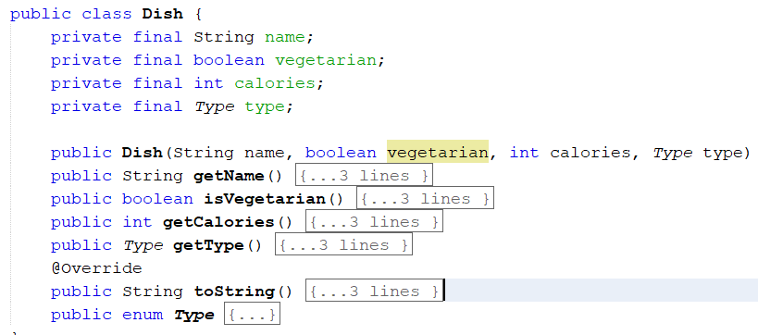
Another Stream API Example

Slide 54
Another Stream API Example
List<Dish> menu = Arrays.asList(
new Dish("beef", false, 700, Dish.Type.MEAT),
new Dish("chicken", false, 400, Dish.Type.MEAT),
new Dish("french fries", true, 530, Dish.Type.OTHER),
new Dish("rice", true, 350, Dish.Type.OTHER),
new Dish("season fruit", true, 120, Dish.Type.OTHER),
new Dish("pizza", true, 550, Dish.Type.OTHER),
new Dish("prawns", false, 300, Dish.Type.FISH),
new Dish("salmon", false, 450, Dish.Type.FISH) );

Slide 55
Another Stream API Example
Consider the following code snippets
List<Dish> vegetarianDishes = new ArrayList<>();
for(Dish d: menu){
if(d.isVegetarian()){
vegetarianDishes.add(d);
}
}
List<Dish> vegetarianDishes =
menu.stream()
.filter(d->d.isVegetarian)
.collect(toList());
Using Stream API
Without using Stream API

Slide 56
Another Stream API Example
Select only the first three
Get s Stream from menu (the list of dishes)
List<String> threeHighCalorieDishNames =
menu.stream()
.filter(d ->d.getCalories() >300)
.map(Dish::getName)
.limit(3)
.collect(toList());
System.out.println(threeHighCalorieDishNames);
Create a pipeline of operations: first filter high-calorie dishes.
Get the names of the dishes
Store the result in another List
The result is [ ]

Slide 57
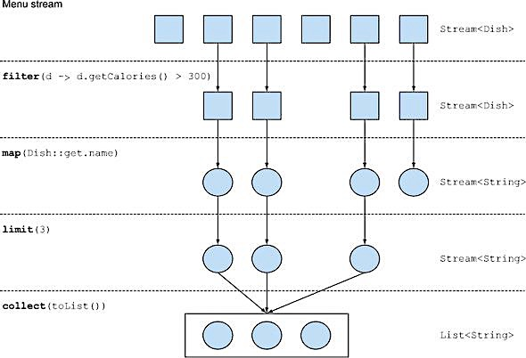
Another Stream API Example

Slide 58
Parallel data processing and performance
One of the most important benefit of Stream API is the possibility of executing a pipeline of operations on collections that automatically makes use of the multiple cores on your computer.
Processing a collection of data in parallel was extremely cumbersome.
First, you needed to explicitly split the data structure containing your data into subparts.
Second, you needed to assign each of these subparts to a different thread.
Third, you needed to synchronize them opportunely to avoid unwanted race conditions, wait for the completion of all threads, and finally combine the partial results.
Java 7 introduced a framework called fork/join to perform these operations more consistently and in a less error-prone way.

Slide 59
Parallel data processing and performance

Slide 60

Lab Exercises

Slide 61
Lab Exercise 1
Simple Word Dictionary Class
Create a map that uses the alphabets as keys and a collection as values (This collection should only contain words starting with the corresponding key)
Develop and application that stores words into that collection.
Elements in the words map for each alphabet should be sorted
Provide methods to print all the letters and corresponding words
Provide a method to print the words of a given letter

Slide 62
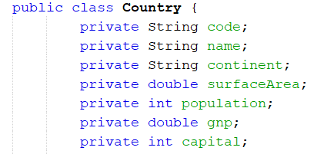
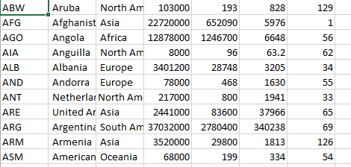
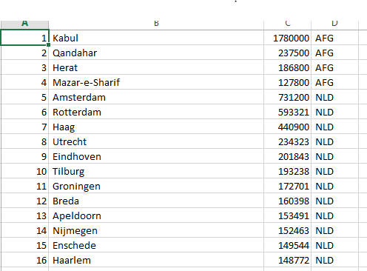
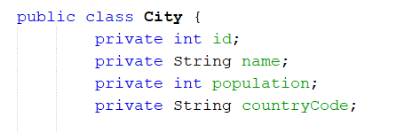
Lab Exercise 1
World Countries:
There are two domain classes: Country and City.
Each city belongs to a country defined by the attribute, countryCode.
Each country has a unique code and has many cities.
The Country class has the following attributes
The City class has the following attributes

Slide 63
Lab Exercise 1
Create the above two classes and then create a java application to find the following:
Find the highest populated city of each country
Find the most populated country of each continent
Find the highest populated capital city

